Slide 1

DIGITAL IMAGE PROCESSING IN MEDICAL APPLICATIONS: A CASE STUDY
Group Members:
Bhargav Pawar
Nishant Bhat
Abhijeet Gawai
Shyam Kawale

Slide 2
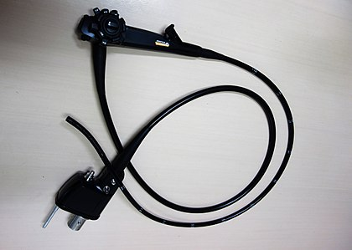
ENDOSCOPY
An endoscopy is a procedure used in medicine to look inside the body. The endoscopy procedure uses an endoscope to examine the interior of a hollow organ or cavity of the body. Unlike many other medical imaging techniques, endoscopes are inserted directly into the organ.
There are many types of endoscopes. Depending on the site in the body and type of procedure an endoscopy may be performed either by a doctor or a surgeon.
A patient may be fully conscious or anaesthetized during the procedure. Most often the term endoscopy is used to refer to an examination of the upper part of the gastrointestinal tract, known as an esophagogastroduodenoscopy.

Slide 3
STEPS INVOLVED IN DECISION SUPPORT SYSTEM
Image Acquisition
Tissue Prep
Patient Prep
Physician
Classification
Input Image
Pre-processing
Extraction of suitable features
Feature post- processing
Classifier Training

Slide 4
TRADITIONAL ENDOSCOPY
Such systems are aimed at supporting a physician during colonoscopy, helping to identify regions within the colon which might be of interest for further investigation.
Polyp detection within the colon is another area of research related to colon cancer detection, since polyps are known to be precursors to colon cancer.
Successful attempts have also been made towards an automated detection of coeliac disease.
Other systems aim for example at detecting tumors or bleeding during bronchoscopy.
Due to the fact that images taken using a traditional endoscope often suffer from various kinds of degradations

Slide 5
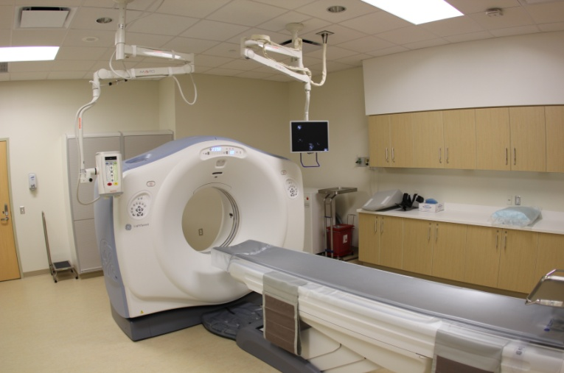
COMPUTER TOMOGRAPHY
Computed Tomography (CT) is a non-invasive technique to provide CT images of every part of the human body without superimposition of adjacent structures. Computed Tomography (CT) is an imaging technique where digital geometry processing can be used to generate a 3D-image.
Computed tomography (CT) of the body uses sophisticated x-ray technology to help detect a variety of diseases and conditions.
It is fast, painless and accurate. In emergency cases, it can reveal internal injuries and bleeding quickly enough to help save lives

Slide 6
WHY IMAGE PROCESSING IN CT SCAN?
Digital picture processing techniques, generally aimed at a transformation from one picture to a modified and improved picture have to meet when applied to computed tomography the following demands:¹
improve the picture with respect to the human perceptional ability .
Reduce noise and scan and motion artifacts .
Obtain a more suitable representation of the picture for the segmentation process.
Image processing techniques can help to differentiate the abnormal tissue growth (tumors) in question from other tissues, providing more detailed information on head injuries, stroke, brain disease and internal structures than do regular X-ray CT scans.

Slide 7
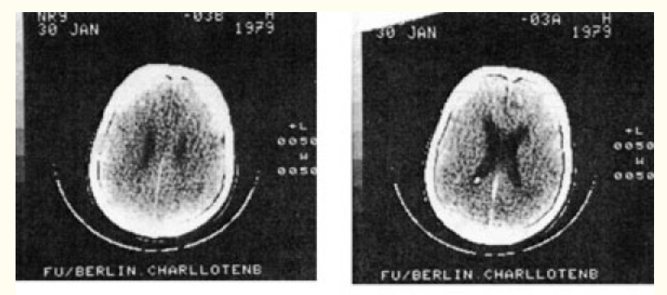
IMAGE PROCESSING TECHNIQUES
Contrast Enhancement
Histogram Equalization
Contour filters
Brush Strokes filter
Segmentation

Slide 8
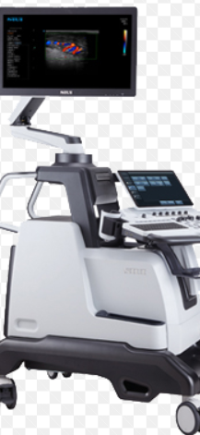
Ultrasonic Imaging System
Ultrasonic Energy is used.
To study internal body organs.
1. Ultrasonic energy is transmitted from a piezo-electric
2. After hitting between two tissues reflections occurs.
3. Reflection captured in transducer.
4. Converted to depth of interface.
5. Displayed on oscilloscope

Slide 9
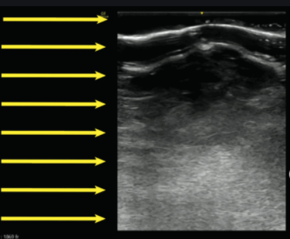
Generating Image
An Image of Interior structure is constructed based of many parameters.
Parameters like total wave travelling time, and energy intensity of reflected waves.
DCG is provided.
Received signals converted into digital signals.

Slide 10
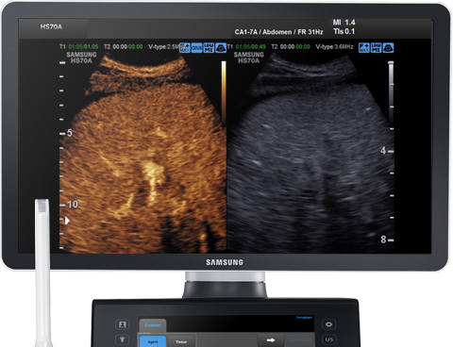
Loading on TV
TV synchronize pulses.
Genrerates X and Y address and feeds to digital memory.
Stored Image is processod by digital-to-analog converter.
Then Feeded to TV monitor.
Again can be converted into digital form using frame grabber to store in PC disk.
Image processing techniques can be used further.

Slide 11
REFERENCES
[1] Noble, Julia & Navab, Nassir & Becher, Harald. (2011). Ultrasonic image analysis and image-guided interventions. Interface focus. 1. 673-85. 10.1098/rsfs.2011.0025.
[2] Qin, Wenjian & Tiexiang, Wen & Zhen, Zheng & Li, Zhicheng & Weisong, Li & Xiang, Fang & Ying, Ji & Jia, Gu. (2012). A pilot study on simulation of Ultrasound from MRI using ray-based model. 632-635. 10.1109/BHI.2012.6211662.
[3] Wein, Wolfgang & Kamen, Ali & Clevert, Dirk-Andre & Kutter, Oliver & Navab, Nassir. (2007). Simulation and Fully Automatic Multimodal Registration of Medical Ultrasound. Medical image computing and computer-assisted intervention : MICCAI ... International Conference on Medical Image Computing and Computer-Assisted Intervention. 10. 136-43. 10.1007/978-3-540-75757-3_17.

Slide 12
THANK YOU

